Slide 1
Indoor Drone Research and Development Project
Group 9

Slide 2
TABLE OF CONTENTS
OUR TEAM & CLIENT
01
04
Sneak Peek
02
05
Major Requirements
Project Stages
03
06
Project Goals
Our Team
Here you could describe
the topic of the section
Here you could describe
the topic of the section
Here you could describe
the topic of the section
Here you could describe
the topic of the section
Here you could describe
the topic of the section
Here you could describe
the topic of the section

Slide 3
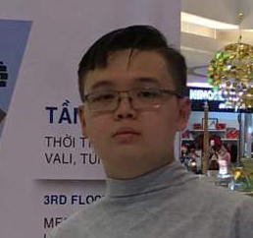
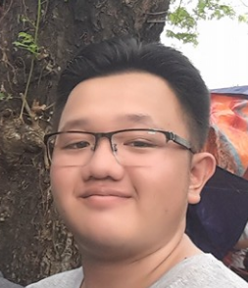
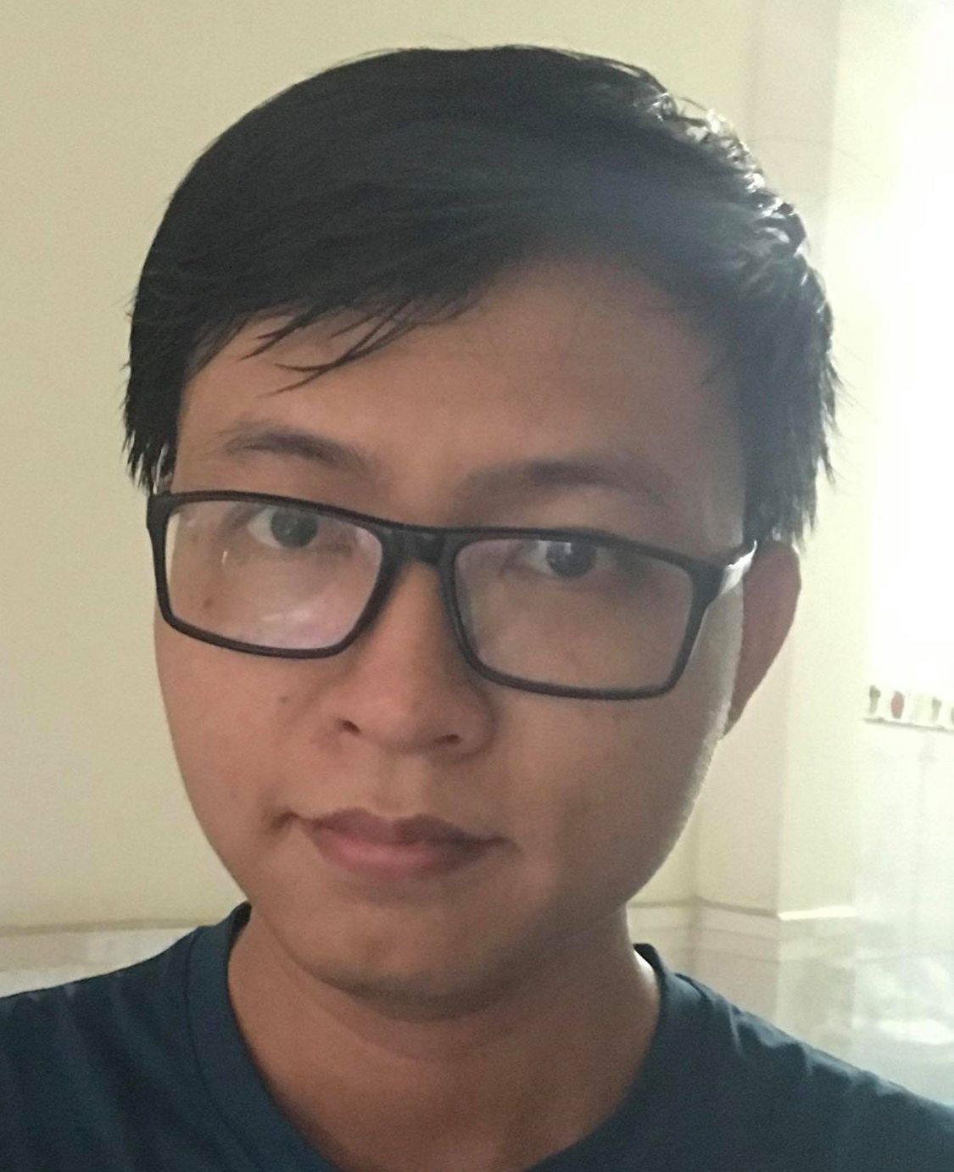
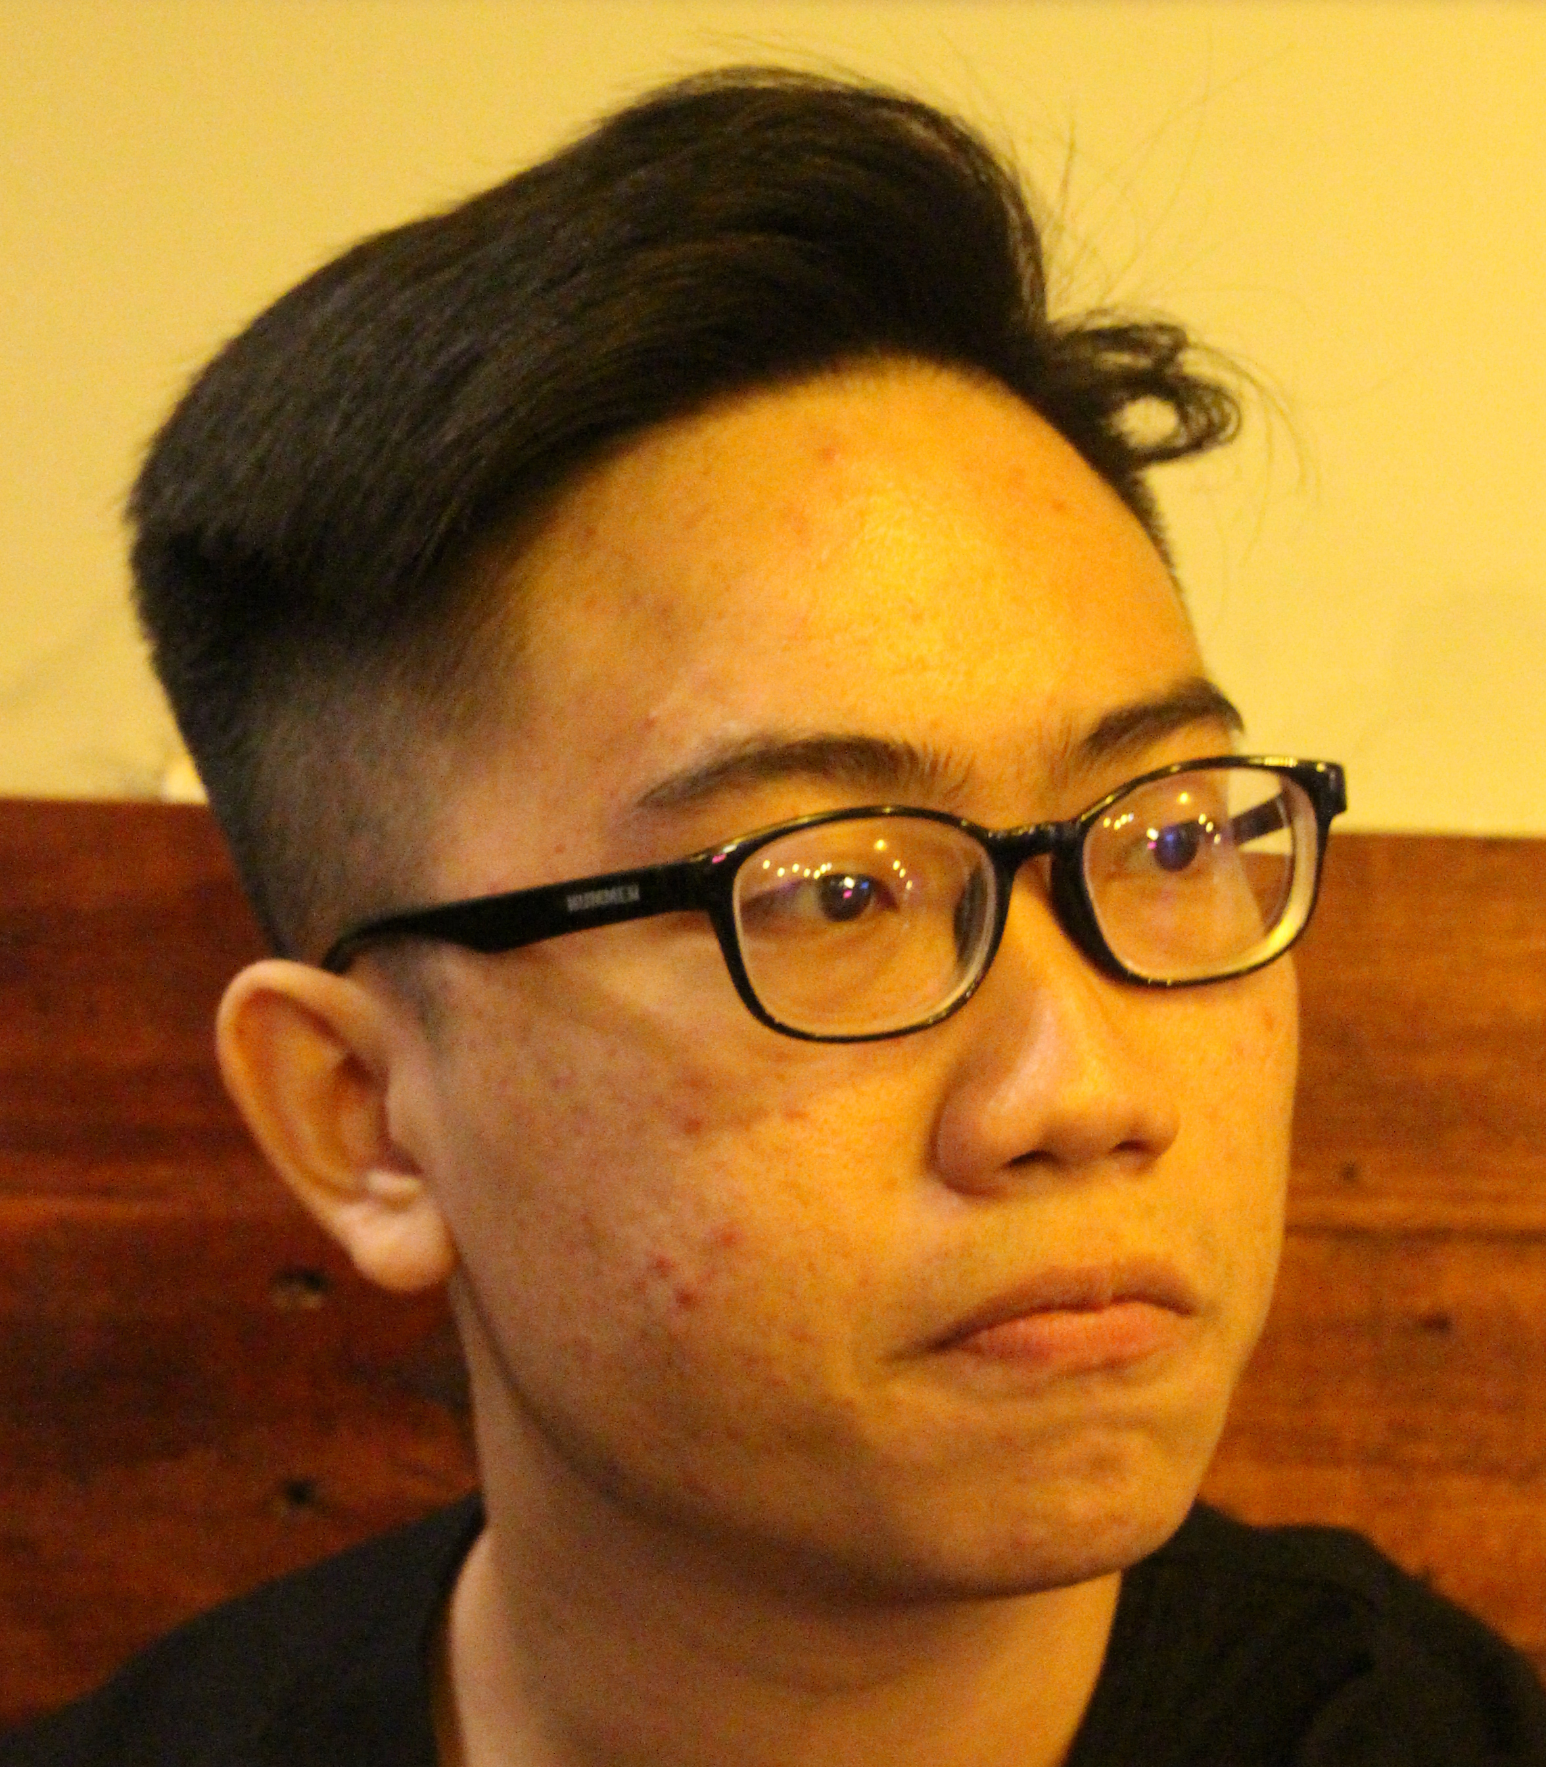
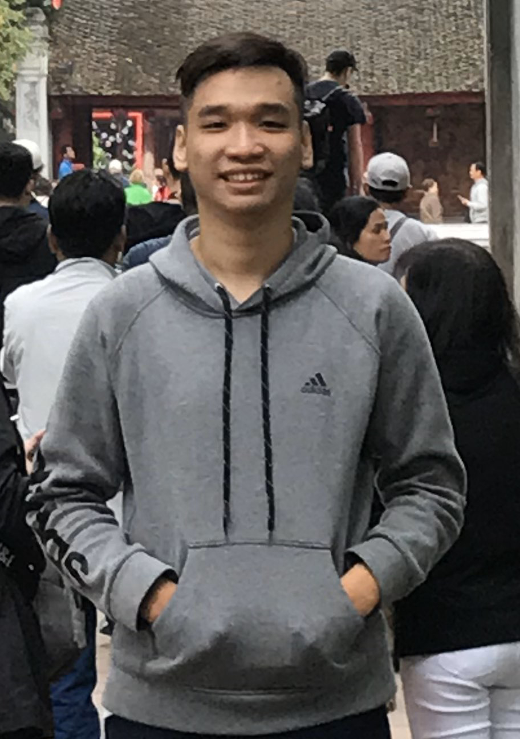
OUR TEAM
TRAN DUC HUY
TRAN HUNG THINH
LE NGUYEN HAN HOAN
DO THIEN Y
NGUYEN MINH QUAN
Project Leader
Developer
Computer Vision
Developer
Business Analyst
Business Analyst, Data Labelling and analytics
Communication, problem solving,
C++, Arduino, Scratch,
electronic fundamental
C++, Python, OpenGL, Machine learning, Data Labelling and analytics
Arduino, Scratch, designing,
electronic fundamental, C++
C++, Communication, problem solving,
Documentation, Business Analyst
Supervised by: Mr. Cao Xuan Nam

Slide 4

OUR CLIENT
Client: Fromlabs Solution LTD
Presented By: Mr.Petteri Kaspenpalo and Mr. Hieu
Address: 8 Burn Road Singapore 369977
Phone: SG (+65) 9235.4689, US (+1) 917.410.0388
Email: info@fromlabs.com

Slide 5
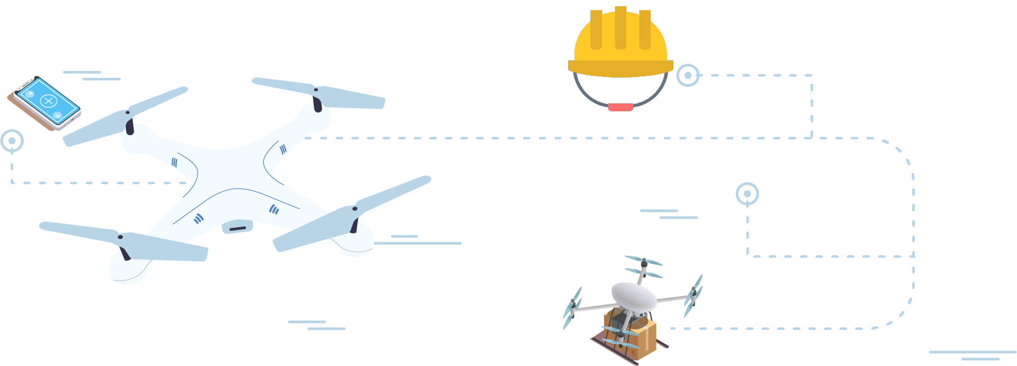
ABOUT THE PROJECT
We’re aiming to introduce drones to assist in tasks automatically without human intervention.
We will be able to introduce a new potential IoT aspect.

Slide 6


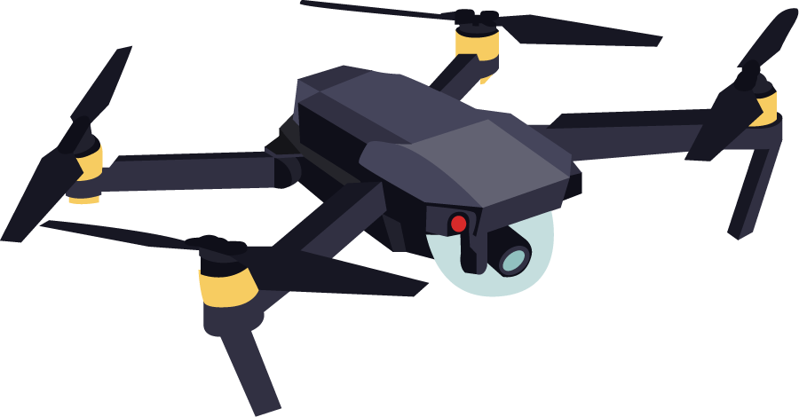




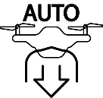

OUR VISION
SIMPLE MOVEMENT
SELF-BALANCE
AVOID OBSTACLE
NAVIGATION
BIG CONNECTION RANGE
OPERATING TIME
AUTO LANDING
SELF OPERATING

